Slide 1
Introduction to the Internet
CSCI 185, Spring 2023 Intro to Computer Programming for the Web

Slide 2
Announcements
Today’s lecture is based on the readings (Timothy B. Lee, 2014).
Our first Tutorial will be Friday (during class). We will be examining how platforms gather data about their users to ‘optimize’ their experiences.

Slide 3
Learning Goals for this Week
During this course, we’ll be building different websites and computer programs that will eventually be part of the Internet. But before we do, we’re going to think a bit about the big picture.
Today: How the Internet works (more technical stuff)
Wednesday & Friday: Societal considerations of the Internet:
How big of an issue is privacy and surveillance on the Internet?
Whose voices and ideas are being amplified / stifled on the Internet (and when / how might this happen)?
Has power and control on the Internet shifted since its initial days? If so, should we care?

Slide 4
Let’s find out what you already know about the Internet...
Notes:
You all are no strangers to the web, and there are a lot of technical jargon flying around, so I’m just curious to see what you all already know...

Slide 5
But first, let’s define it…
A series of tubes to transmit data.
An intangible world.
A storage facility for data
Can transmit any kind of data and if you have a device, it can be reconstituted on the other side.
The data may or may not be true – so you need more data. Or you research.
– Start here on Wednesday –

Slide 6
But first, let’s define it…
“The Internet” can be used in a lot of different ways:
Today we’ll be talking about “The Internet” in terms of its technical infrastructure (e.g. fiber optic cables, “last mile” networks, data centers, and TCP/IP).
On Wednesday & Friday, we’ll be discussing “The Internet” in terms of the “social life of the internet”(i.e., content and services the run on top of internet infrastructure).
Oftentimes “The Web” and “The Internet” are used interchangeably. But from a CS perspective, they’re very different:
The Internet refers to the physical network infrastructure + TCP/IP protocol
The Web is one application that runs on top of the internet (others include zoom, email, telnet, ssh, etc.).

Slide 7
Some questions about the Internet...
What is the cloud?
Who invented the Internet?
Where is the Internet?
Who controls the Internet?
What is Net Neutrality?
Who can access your data over the internet?

Slide 8
What is the cloud? What are some examples of cloud services?
The cloud is basically having access to someone else’s computer(s)
Refers to software and information and computing services (including storage) that run on someone else’s computer instead of on yours
Cloud services can be accessed through a Web browser like Firefox or Google Chrome, through mobile devices, IoT services, etc.
What this means is that your computer is constantly interacting with the cloud.
Bottom line: your devices are interacting with other services and systems (i.e., other businesses and people) all of the time. This isn’t necessarily a bad thing, but it’s important to think about!

Slide 9
Who Invented the Internet?
The internet began as ARPANET, an academic research network that was funded by the military (DARPA), beginning in 1969
In 1973, Vint Cerf and Bob Kahn began work on TCP/IP, the next networking standards that became the foundation of the modern internet
In 1981 funding for the internet shifted to the NSF, which funded the long-distance networks that served as the internet’s backbone until 1994
In 1994, the Clinton Administration privatized the internet backbone
Source: https://www.vox.com/2014/6/16/18076282/the-internet

Slide 10
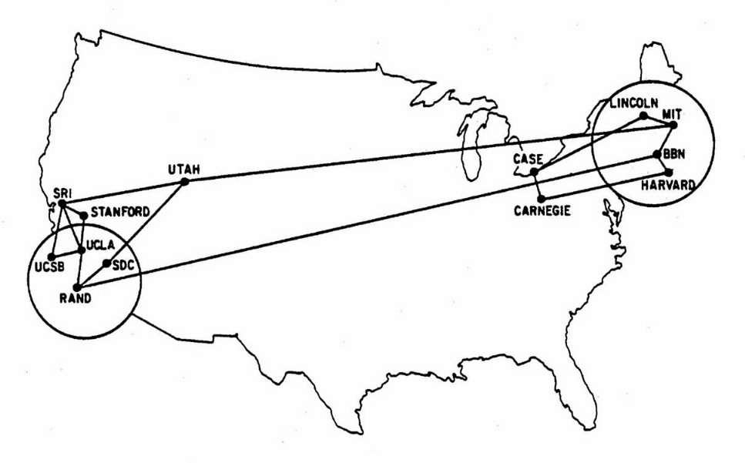
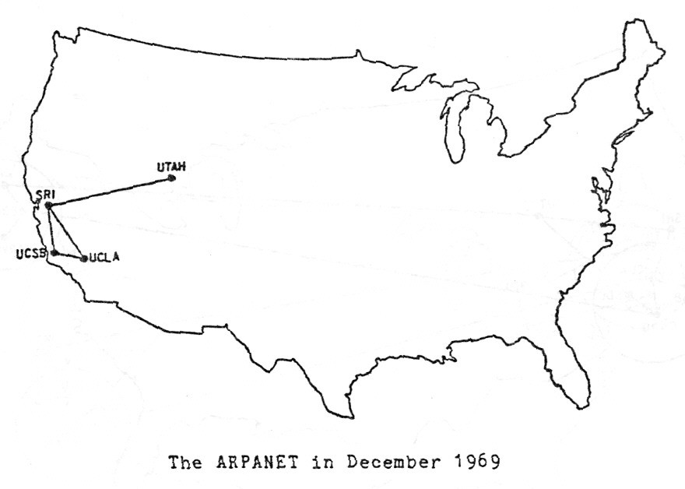
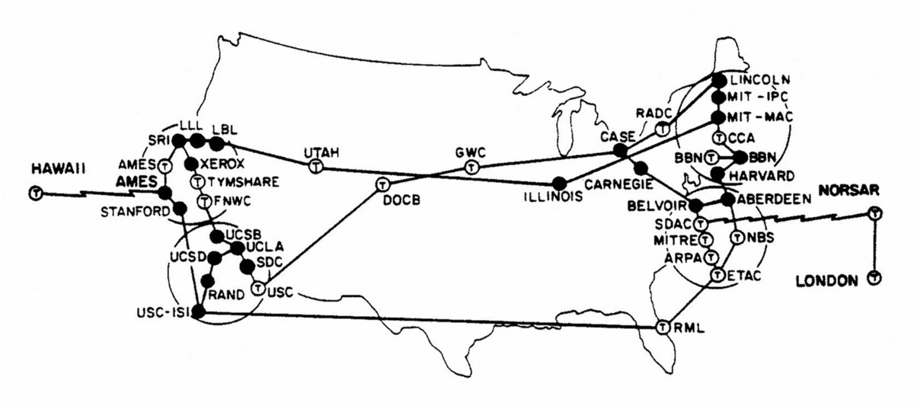
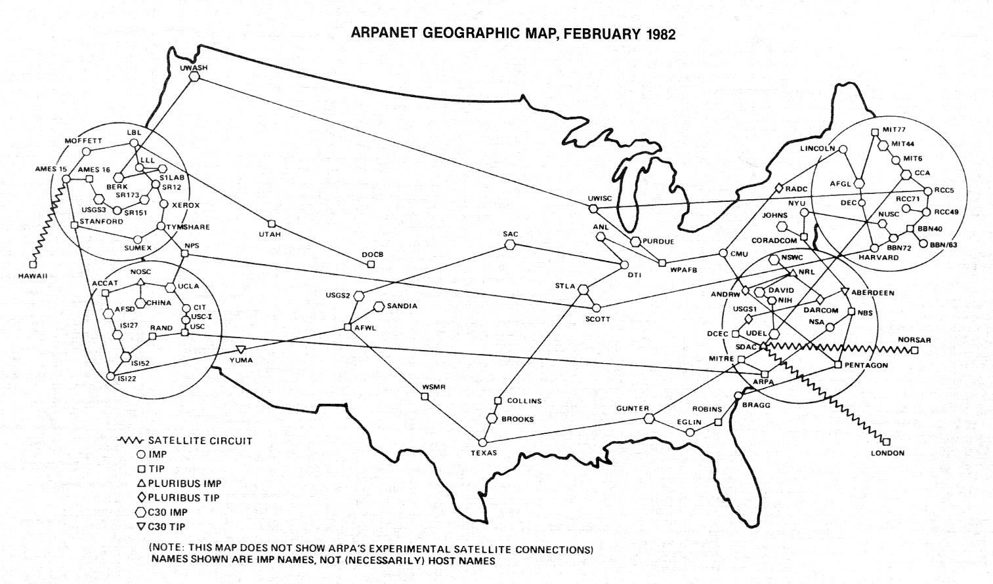
1969
1970
1973
1982
Source: https://www.vox.com/a/internet-maps

Slide 11
Where is the Internet?
Three primary components:
The Internet Backbone Long-distance networks — mostly on fiber optic cables — that carry data between data centers and consumers
The “Last Mile” The part of the internet that connects homes and small businesses to the internet.
Data Centers Can be located anywhere in the world, but they are often located in remote areas where land and electricity are cheap.
Source: https://www.vox.com/2014/6/16/18076282/the-internet

Slide 12
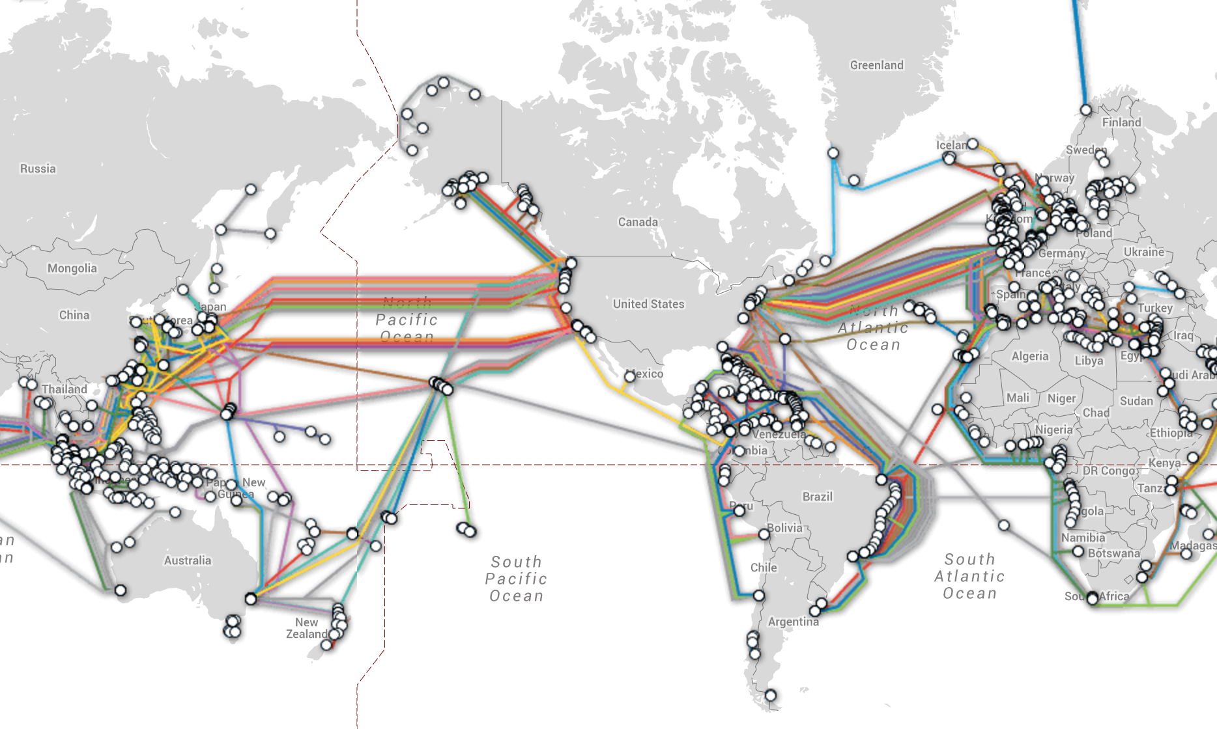
Internet “Backbone”: Global

Slide 13
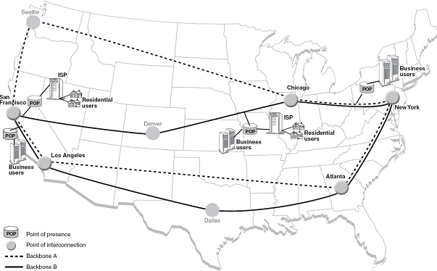
Internet “Backbone”: National
A very high-speed data transmission line that provides networking facilities to relatively small but high-speed Internet service providers all around the world.
Some of the largest companies running different parts of the Internet backbone include UUNET, AT&T, GTE Corp. and Sprint Nextel Corp.
Source: http://computer.howstuffworks.com/bpl4.htm

Slide 14
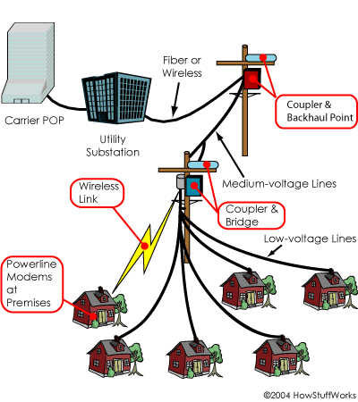
The “Last Mile”: Local
The final connectivity leg between the telecommunication service provider and an individual customer (e.g. Comcast, RCN, etc.).
The most widely used last mile technologies are DOCSIS (xDSL Cable and Cable Modem Access), fiber optic, or wireless access.
Source: http://computer.howstuffworks.com/bpl4.htm

Slide 15
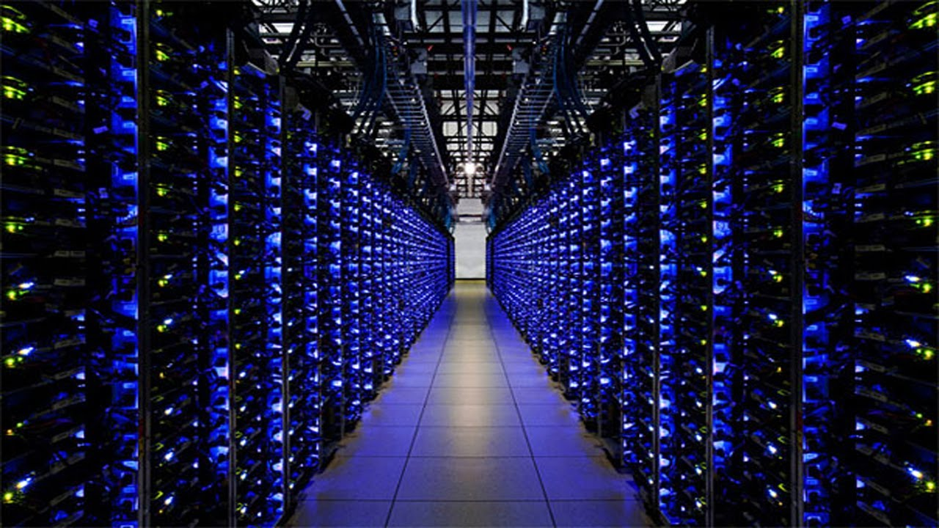
Pictured: A Google Data Center

Slide 16
Who controls the Internet?
No one runs the Internet. It’s organized as a decentralized network of networks.
Thousands of companies, universities, governments, and other entities operate their own networks and exchange traffic with each other based on voluntary interconnection agreements
There are technical standards committees (ICANN, IETF, etc.) that do meet and agree on rules of traffic exchange
Governments can filter and block traffic (as can companies, schools, etc.)
Source: https://www.vox.com/2014/6/16/18076282/the-internet

Slide 17
What is Net Neutrality?
The principle that Internet service providers and governments should treat all data on the Internet the same, not discriminating or charging differentially by user, content, site, platform, application, type of attached equipment, or mode of communication. In the US, this is controlled by the FCC.
Repealed in 2015, championed by Ajit Pai
Biden administration revisiting this determination
Questions to think about:
What are the arguments FOR certain kinds of traffic getting prioritized?
What are the arguments against it?
Source: see article in course-website/course-files/readings/FCC net neutrality repeal -- what you need to know - CNET.pdf
Notes:
What are the pros and cons of net neutrality? Do you think they’re legitimate?

Slide 18
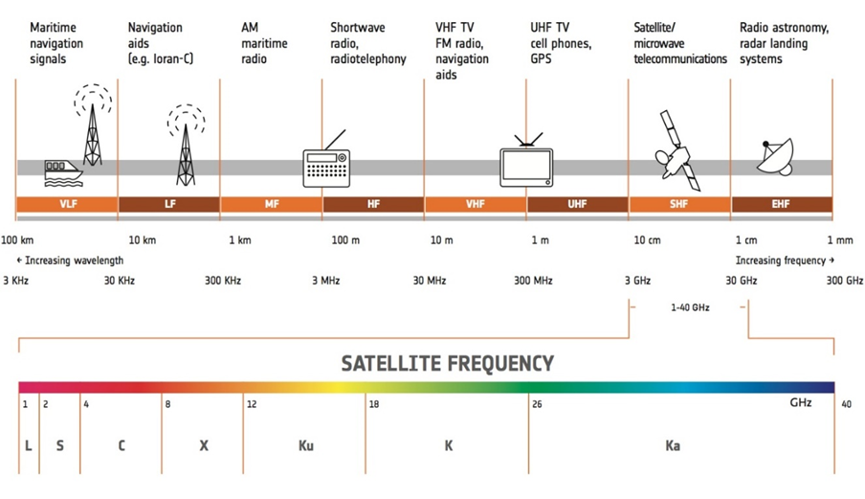

Slide 19
Who can access your data (transmission & storage)?
What did the 2013 Snowden leaks reveal?
Britain's “Tempora” taps fiber optic cables around the world
NSA could hack into Google and Yahoo data centers w/o their knowledge
Verizon had been providing the NSA w/all of its phone records
NSA can request user data from companies, which they are compelled to deliver on by law (PRISM)
NSA undermines encryption via backdoors and promoting the use of weaker algorithms
Sources:
See course-website/course-files/readings/The 10 Biggest Revelations From Edward Snowden's Leaks _ Mashable.pdf

